Slide 1
Predicting Reassault
Capper, M., De Dios, E.C., Ruiz, J.J.
Codeup

Slide 2
If you or somebody you know
might be experiencing
domestic violence,
please call
1-800-799-7233.

Slide 3
THE DATA

Slide 4
SLAPPING
The correlation between the occurrence of slapping and re-assault is perhaps the most striking observation encountered in this exploration. Here, it can be observed that the average rate of re-assault raises exceptionally, merely by the occurrence of one slapping incident.

Slide 5
POWER & CONTROL
The Power scale is an aggregate measure from 0-5 based on the following inquiries:
In the past year, an intimate partner...
Was jealous and didn’t want you to talk to other men (women)?
Tried to limit your contact with family or friends?
Insisted on knowing who you are with and where you are at all times?
Called you names to put you down or make you feel bad?
Prevented you from knowing about or having access to family income, even if you ask?

Slide 6
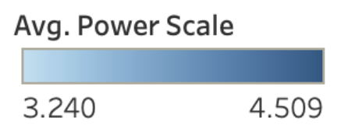
AGE DISPARITY
Age disparity between perpetrator and respondent:
3: Perpetrator is older by 21-42 years 2: Perpetrator is older by 10-20 years 1: Perpetrator is older by 5-9 years
0: same age & within 5 years 1: Respondent is older by 5-9 years 2: Respondent is older by 10-20 years

Slide 7
THE MODEL*
Accuracy: 84%
 | Precision | Recall
No Reassault | 83% | 80%
Reassault | 84% | 87%
* Logistic Regression using the liblinear solver.

Slide 8
Capper, M., De Dios, E.C., Ruiz, J.J. (2019). Predicting Reassault. Unpublished Capstone Project, Codeup, San Antonio, Texas.
https://ddfloww.com/domestic-violence

